Slide 1


Graph Neural Network for Building Prediction Agents in Intent-Based Zero-Touch Networks
Paper No: 22
Authors:
Dangnachew Azene Temesgene | Elham Dehghan Biyar | Andrey Silva | Ankita Likhyani | András Zahernszky
Ericsson Research, Sweden | Ericsson Research, Turkey | Ericsson Research, Brazil | Ericsson GAIA, India | Ericsson Research, Sweden
Source: 2024 IEEE International Conference on Communications (ICC)
Presented By: UMAR MUHAMMAD
Student ID: 20245364
Date: 2025-11-27
Department of Electrical Electronics and Computer Engineering, University of Ulsan, Ulsan, South Korea
1

Slide 2
Presentation Outline
Part 1: Background and Motivation
The Evolution: 5G → 6G Networks
What are Intent-Based Networks?
The Critical Problem: Conflict Detection
Part 2: Related Work and Problem Context
Part 3: Experimental Setup and Results
Part 4: Proposed GNN Framework
Why Traditional Methods Fail
Why Graph Neural Networks?
GNN Architecture & Training
Part 5: Key Takeaways and Discussion
Main Contributions
Limitations and Future Work
2

Slide 3


The Evolution of Network Management
4G (2010) | 5G (2020) | 5G-Adv (2024) | 6G (2030) | Future (2035+)
Manual Config
Partial Automation
Semi-Auto
Autonomous Operation
Fully Auto Zero-Touch
Complexity Explosion
4G Network:
1,000 base stations
100,000 parameters to configure
Human engineers: Manageable
6G Network (Projected):
10,000,000 connection points
100,000,000,000+ parameters
Human engineers: IMPOSSIBLE
THE CHALLENGE!
How do we manage networks that are too complex for human operators to configure manually?
ANSWER: Intent-Based Autonomous Networks
3

Slide 4
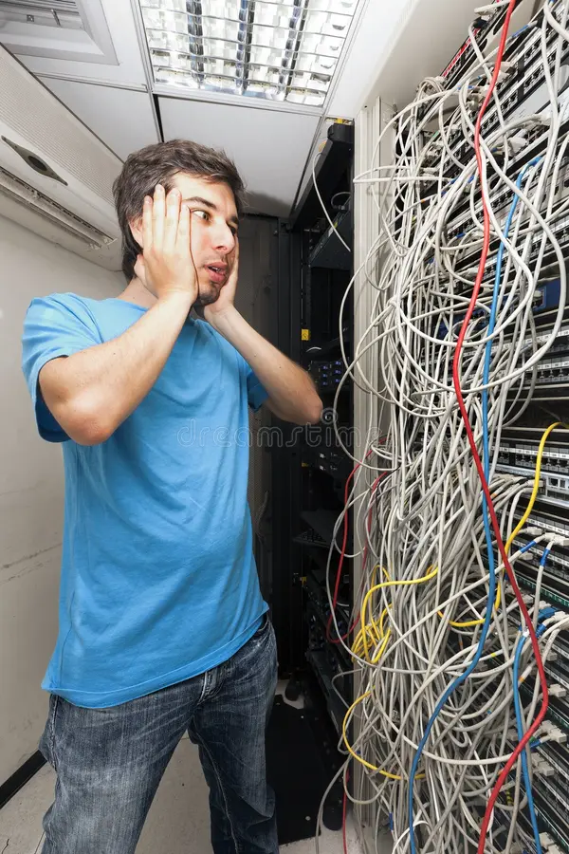
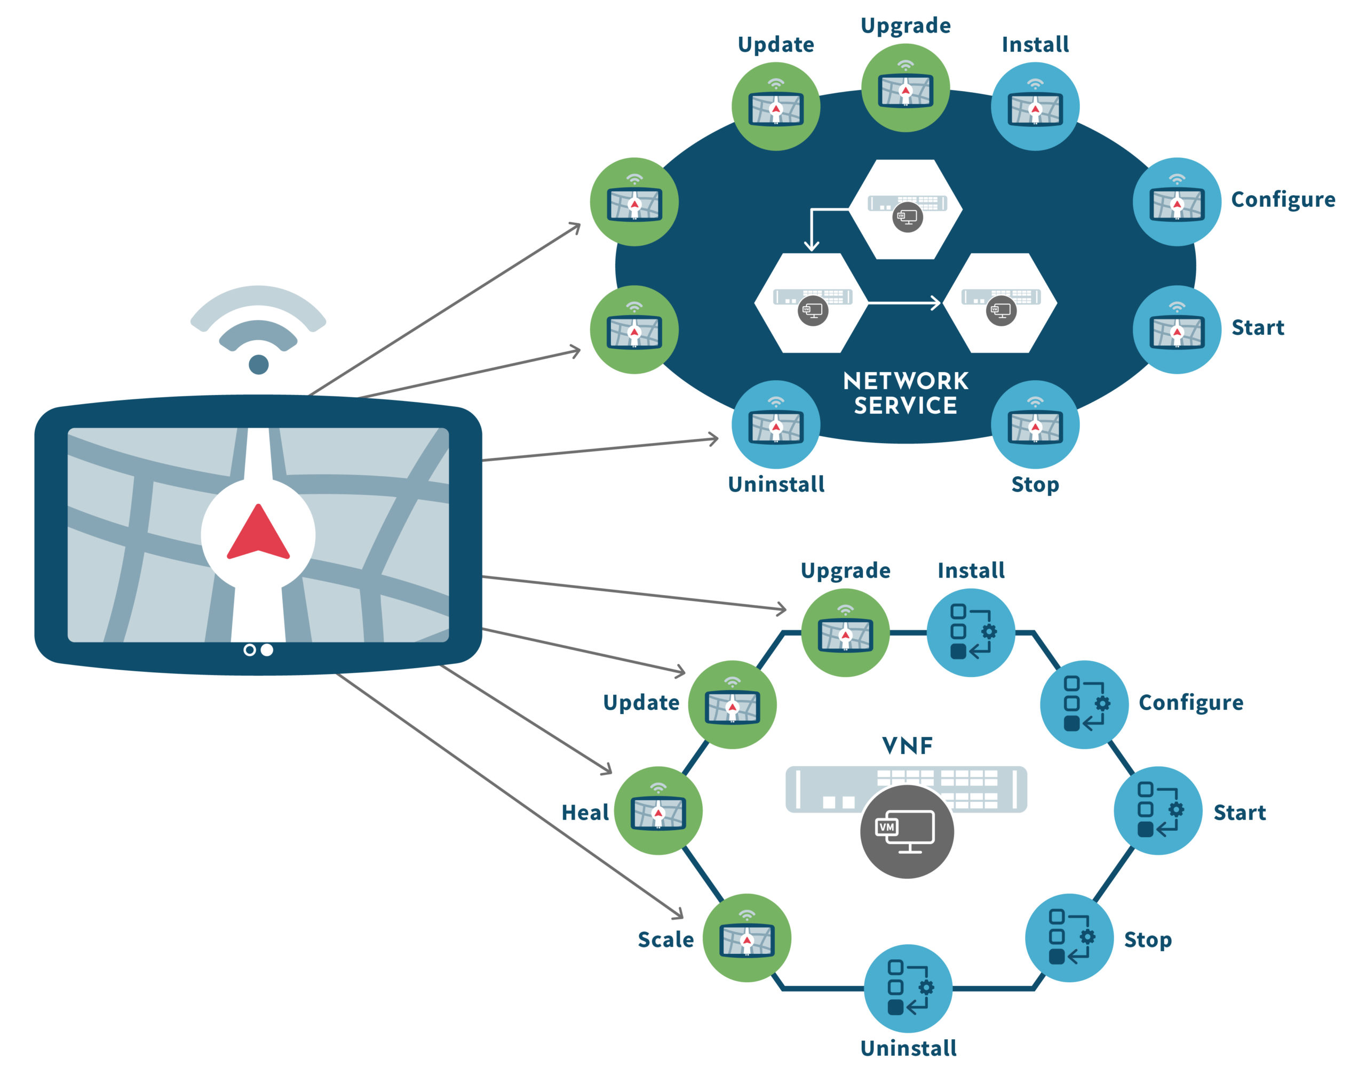
The Problem: Networks Are Becoming Too Complex
Why Do We Need Intent-Based Zero-Touch Networks?
Modern networks = millions of parameters
(traffic patterns, service requirements, topology changes)
Human configuration is no longer scalable
→ Too slow
→ Too error-prone
→ Too complex
Services are becoming diverse
URLLC needs ultra-low latency
Conversational video needs high QoE
IoT devices need massive connectivity
Conflicts naturally appear
Changing one setting may break another service's KPI
Future 6G vision
→ Autonomous, self-optimizing, self-healing networks
→ Operated not by commands, but by intents
(a)
(b)
Fig 1. Tangled manual networks to clean, intent-driven network
4

Slide 5
What Are Intent-Based Networks?
From Manual Commands to High-Level Intents
Traditional (Configuration-Based)
Network Engineer specifies HOW:
↓
Set Router 1: QoS policy=7, bandwidth=50Mbps
Set Router 2: Priority=high, buffer=2048KB
Configure Switch 1: VLAN=105, MTU=9000
[... 50 more commands ...]
↓
Time: Hours to Days
Error Rate: 5-10% (human mistakes)
Scalability: Poor (limited by human capacity)
Intent-based (Goal-Based)
User specifies WHAT they want:
↓
"99% of URLLC users should experience maximum latency of 60ms and packet loss <1%"
↓
System automatically:
- Translates intent → configurations
- Configures all network elements
- Monitors continuously
- Adapts to changes
- Resolves conflicts
↓
Time: Seconds to Minutes
Error Rate: <0.1% (automated)
Scalability: Excellent (handles millions)
Table 1. A side-by-side comparison:
Manual Configuration | Intent-Based Network
Hundreds of CLI commands | Keep Latency < 60 ms
Reactive | Proactive and Predictive
Human-operated | Self-driving
5

Slide 6


Problem Statement and Existing Challenges
Why existing approaches are insufficient
Main Challenges
1. Complexity: Mathematical models (queuing theory, Markov chains) cannot capture dynamic network complexity [3].
2. Scalability: Traditional ML approaches (MLP, CNN) show poor generalization on large-scale networks.
3. Accuracy: Prediction agents must be fast, accurate, and scalable for run-time conflict detection.
4. Generalization: Models trained on one configuration should work on unseen topologies.
Research Question: Can Graph Neural Networks (GNN) enable accurate, scalable, and generalizable prediction agents for intent-based networks?
Paper's Goal
To develop a GNN framework that predicts KPIs (specifically latency) for intent-based networks by learning from the underlying graph representation of the network environment.
6

Slide 7
Related Work
GNN applications in network management
Work | Application | Key Contribution
RouteNet [10] | Delay Prediction | GNN recognizes topologies for per-path delay
Wang etal. [8] | Network Slicing | Virtual network representation, E2E metrics
STGCN [11] | SDN latency | Spatial-temporal forecasting in Abilene network
PERT-GNN [13] | Microservices | Latency prediction for resource allocation
Research Gap
No prior work focuses on automatic generation of prediction models for conflict detection in intent-based network management systems
Why GNNs?
Networks ARE graphs!
GNN Advantage
Native topology modeling
7

Slide 8
Data Collection: Network Emulator
Realistic test environment (Virtual 5G Network)
Network Components
Two Active Services
UEs: User equipment (URLLC and CV users)
Ultra-reliable low latency communication (URLLC)
Request-response with computational tasks
gNodeB (gNB): 5G base station
UPF: User Plane Function, managing routing
Video Call Streaming (WebRTC)
Conversational video streaming
Kubernetes Clusters: Central, Edge-1, Edge-2
User-plane probes: Traffic monitoring
Table 2. Configuration Details
Config | Airlink BW | WebRTC UEs | URLLC UEs | Delays (ms)
Config 1 | 10 Mbps | 3 | 5 | Edge1:2, Edge2:15, Central:50
Config 2 | 20 Mbps | 5 | 15 | Edge1:2, Edge2:15, Central:50
Config 3 | 10 Mbps | 5 | 15 | Edge1:2, Edge2:15, Central:50
8

Slide 9
Network Actions and Collected Features
1. Autoscale Limit Changes
Horizontal scaling: increase/decrease number of replicas (pods) in Kubernetes clusters.
2. Priority Adjustments
Adjust priority levels for both WebRTC and URLLC UEs to control airlink bandwidth sharing.
3. UE Mobility
Migrate UE context between Edge-1, Edge-2, and Central clusters.
Result
892 graphs with 11,000+ UE records.
Actions were taken at random intervals to generate diverse network states
1. Mobility 2. Network congestion 3. Scaling services based on load
Collected Features
UE Level: throughput, latency, packet loss, priority, QoE
Network Level: link capacity, delay, gNB ID
Cluster Level: replicas, CPU load, deployed site
9

Slide 10
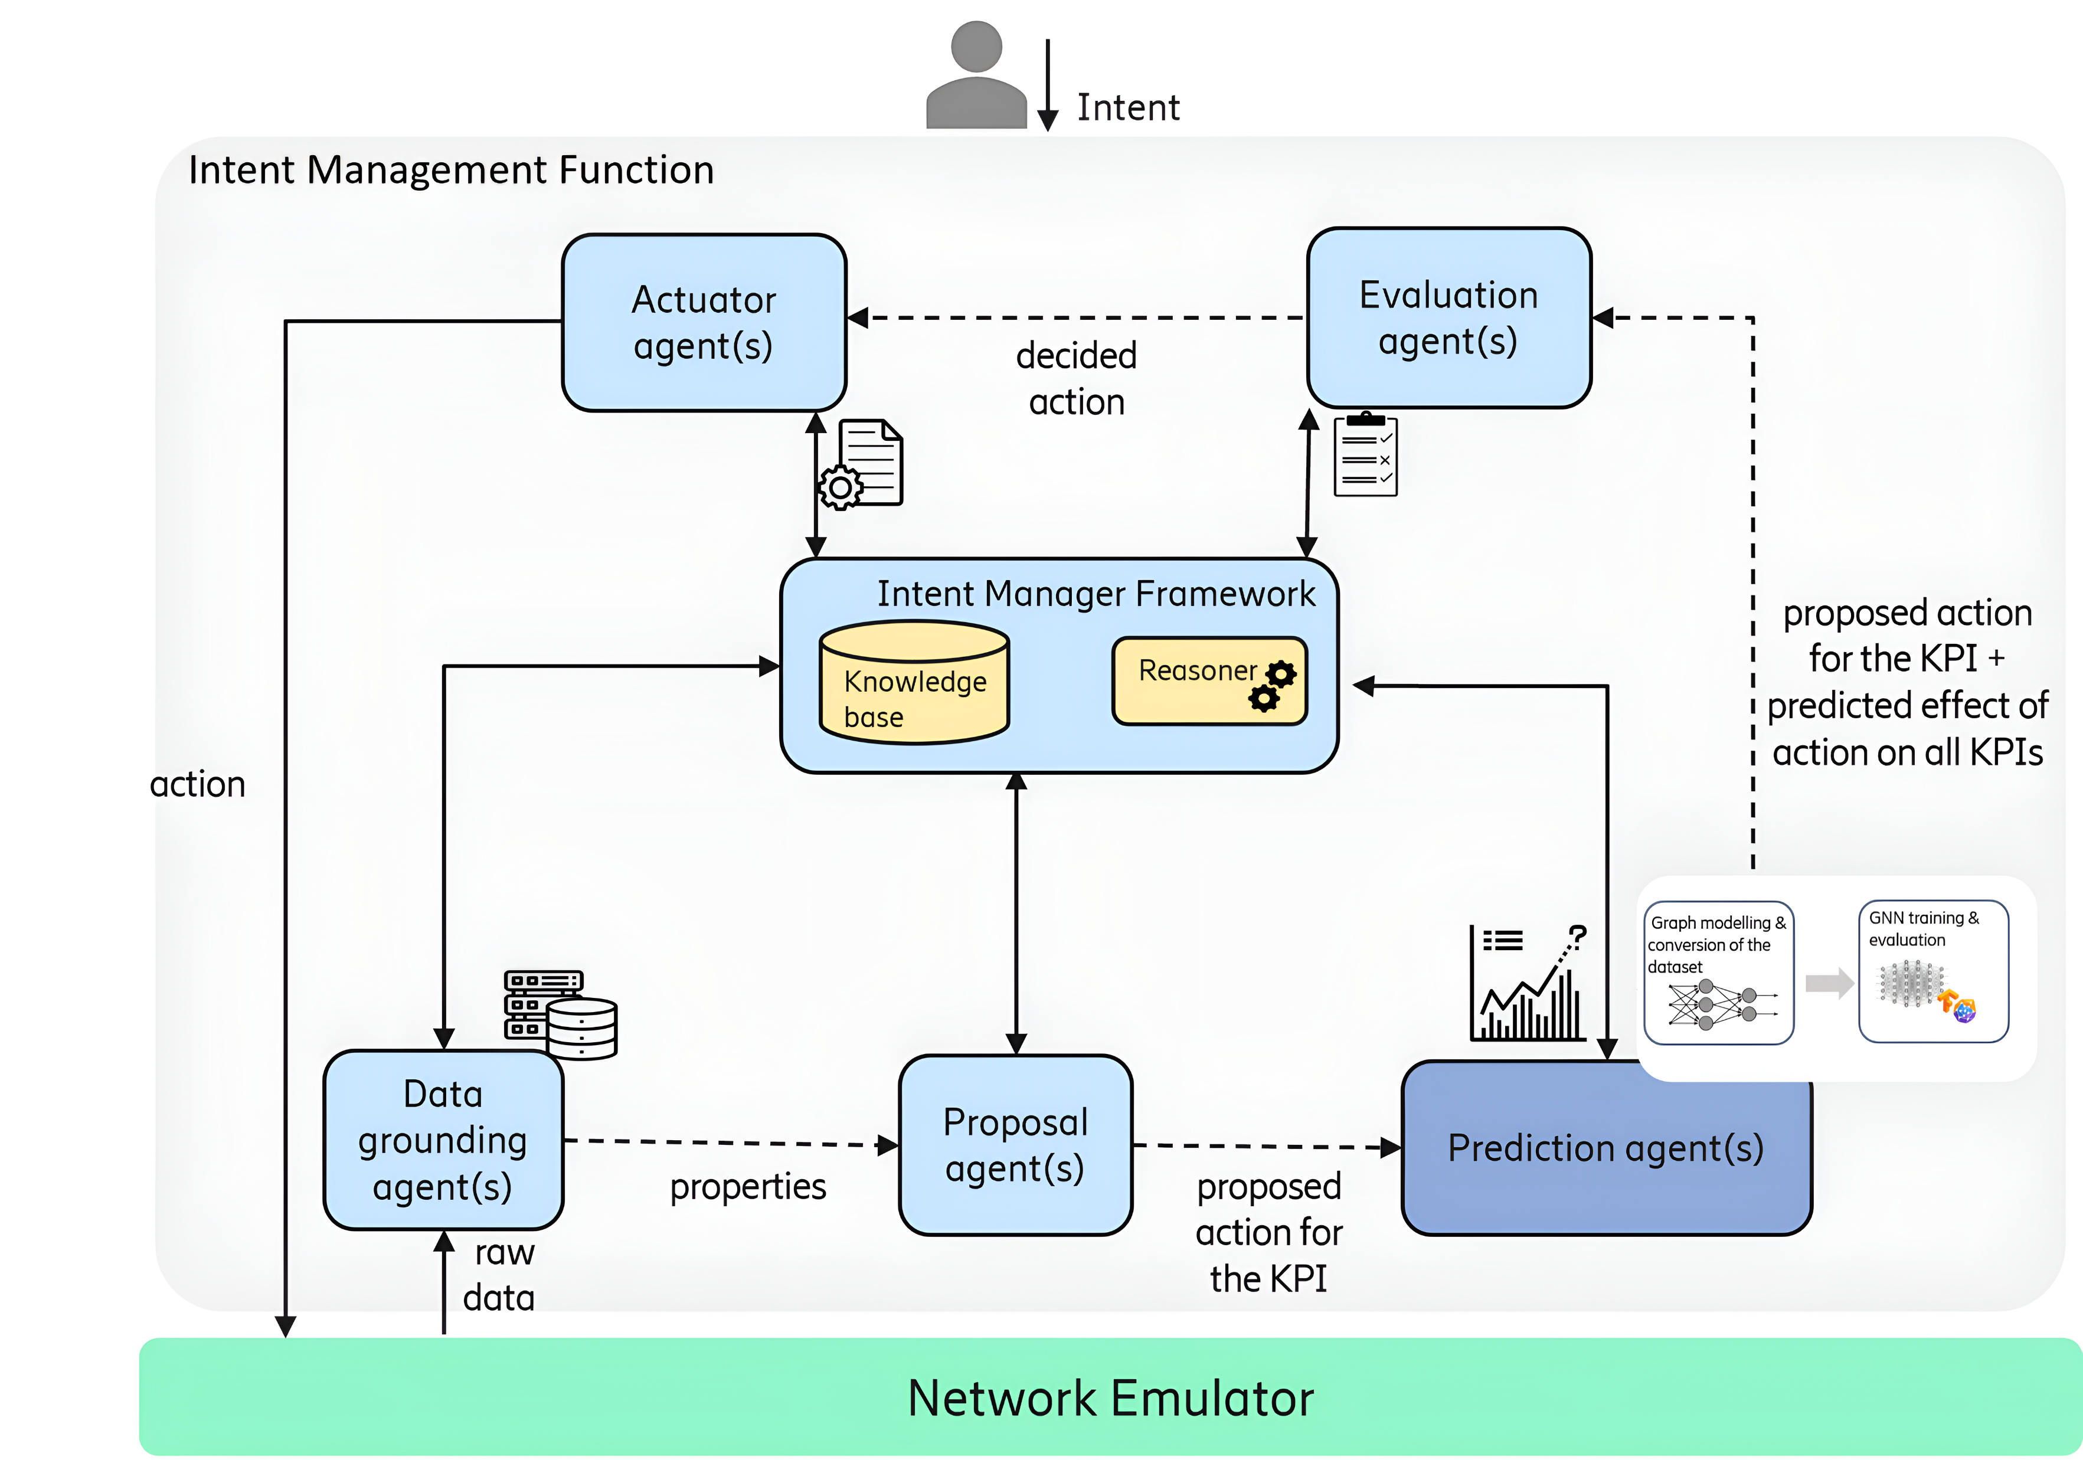
Intent Manager Function: The Brain of Intent-Based Networks
The Intent Manager Function (IMF): How Intents Become Actions
LAYER 1: USER / SERVICE LAYER
Users submit high-level intents in business language. Example: 'I want 99.9% availability' or 'I need low latency for video streaming.' These intents are passed to the IMF for translation into network configurations.
LAYER 2: INTENT MANAGEMENT FUNCTION (IMF) - THE INTELLIGENT CORE
The IMF uses the MAPE-K control loop (Monitor, Analyze, Plan, Execute, Knowledge) to autonomously manage the network through continuous closed-loop operation:
1. MONITOR (Data Grounding Agent):
Collects KPIs from the network (throughput, latency, packet loss, resource utilization), processes real-time measurements, and compares them against intent targets.
2. ANALYZE (Proposal Agent):
Identifies root causes when intents are not fulfilled. Generates multiple possible corrective actions (e.g., increase bandwidth, change routing, reallocate resources). Passes proposals to Planning stage.
3. PLAN (Prediction Agent) ← THE PAPER'S CONTRIBUTION:
Predicts the impact of each proposed action on ALL active intent KPIs. Detects potential conflicts (fixing one problem might violate other intents). Evaluates alternatives and selects the best action that optimizes overall performance without conflicts. This predictive capability enables truly autonomous zero-touch network operation.
4. EXECUTE (Actuator Agent):
Applies the selected configuration to network elements (routers, switches, base stations). Implements the chosen solution and loops back to Monitor stage to verify the outcome.
LAYER 3: NETWORK ELEMENTS LAYER
Physical and virtual infrastructure (routers, switches, base stations, servers). Receives configuration commands from IMF and executes them. Sends monitoring data back to complete the feedback loop for continuous autonomous management.
Fig 2. Overview of the Intent Manager Function architecture.
11

Slide 11
MAPE-K Control Loop with Prediction Agent
Step 1 - MONITOR: The monitoring agent measures network performance. Here, for example it found that URLLC latency is 75 milliseconds, but the target is less than 60 milliseconds. This violation triggers the next stage.
The system detects a problem
Step 2 - ANALYZE: The analysis agent identifies that CPU overload is causing the problem. It then generates three possible solutions: add more server replicas, move users closer to the edge, or increase the priority of URLLC traffic. These proposals go to the planning stage.
The system identifies the reason
Step 3 - PLAN with Prediction Agent (THE PAPER'S CONTRIBUTION): This is where the paper contribution comes in. The Prediction Agent uses GNN to predict what will happen if we implement each proposed action. It doesn't just look at URLLC latency it predicts the impact on ALL network services.
For the first action, adding replicas: It predict the latency will drop to 55 milliseconds, which is good. But video quality will decrease to 4.3 out of 5, and it costs 840 dollars per month.
For the second action, moving users to the edge: Latency improves to 45 milliseconds, video quality actually improves to 4.6 out of 5, and it only costs 120 dollars per month. This is clearly the best option.
For the third action, increasing priority: Latency becomes 50 milliseconds, which meets our target. But video quality drops significantly to 3.8 out of 5. Even though this option is free, it creates a conflict with the video streaming requirements.
The Prediction Agent selects the second action because it satisfies all requirements without creating new problems. This shows why prediction is critical, without it might choose the free option and unknowingly create video quality issues.
KEY INSIGHT: The Prediction Agent is the brain of autonomous networks. It evaluates all options before taking action, detects conflicts between different requirements, and selects the best overall solution. Without accurate prediction, the system would make decisions blindly and create new problems while trying to solve old ones.
Step 4 - EXECUTE: The system now implements the selected action. It migrates five users to the edge server and monitors the results to confirm success.
Step 5 - KNOWLEDGE: The system stores this experience and updates its prediction models. This learning improves future decisions. The loop then returns to monitoring.
12

Slide 12
How Does the GNN Learn?
1. Represent Network as a Graph
2. Multistage Message Passing (MSMP)
Nodes = UEs, Gateway, and Edge/Central clusters
Edges = Connections between them
Each node has features (e.g., throughput, QoE, replicas, CPU load)
Nodes exchange information with neighbors in multiple stages:
Stage 1: UE ↔ Gateway
Stage 2: Gateway ↔ Cluster
Aggregation function (SUM) combines messages from all neighbors.
3. Update Node States (Embeddings)
4. Readout Layer (Prediction)
Each node updates its internal representation using a neural network.
Embeddings capture:
Node features
Network structure
Load, delays, traffic interactions
A feed-forward NN takes the final embedding of each URLLC UE.
Outputs the predicted latency.
5. Train End-to-End
Compare predicted latency vs. real latency (RMSE loss).
Use backpropagation to update model weights.
Repeat until prediction is accurate.
13

Slide 13
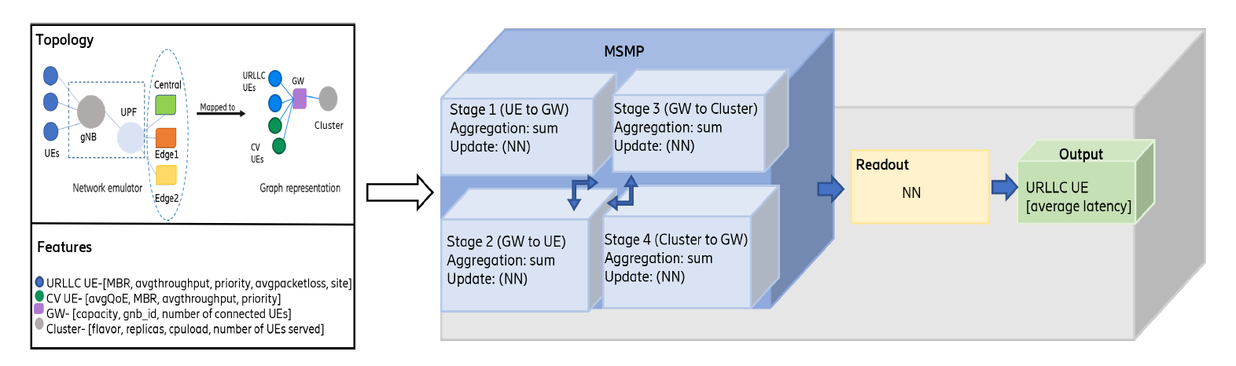
Proposed Method Architecture
How raw network data becomes a latency prediction using GNN.
Fig 3. Internal architecture of GNN-based prediction agent
The figure shows how it transform the emulator network into a graph, propagate information between UEs, gateway, and clusters in multiple stages, and then use a neural network readout to predict URLLC latency for each UE.
14

Slide 14
GNN Training Details
Step 1: Enable Trace System
└─ Generate desired outputs from network emulator
Step 2: Collect Raw Data
└─ Store in table format: KPIs, topology, configurations
Step 3: Data Preprocessing
├ Convert to graph format
├ Normalize features (0-1 range)
├ Filter outliers (throughput < 50 Kbps)
└─ Result: 892 valid graphs
Step 4: Train/Test Split
└─ 80% training / 20% testing
Step 5: Model Training and Evaluation
└─ Train GNN and evaluate on test set
Table 4. Parameters for GNN Training
Design Choices
Parameter | Value
Embedding size | 64
Layers | 4
Aggregation | sum
Learning rate | 0.001
Dropout probability | 0.3
Optimizer | Adam
Readout Function: MLP (Multi-Layer Perceptron)
Activation Function: ReLU
Update Function: Feedforward NN
15

Slide 15
GNN Training Process
Training Process
Step 1: DATA PREPARATION
├─ Convert network snapshots to graphs
├─ Normalize all features to [0, 1]
├─ Filter outliers (throughput < 50 Kbps)
└─ Result: 892 clean graphs
Step 2: DATA SPLITTING
├─ 80% training graphs
├─ 20% testing graphs
└─ Separate holdout configuration
Step 3: TRAINING LOOP (300 epochs)
├─ For each batch of 32 graphs:
│ ├─ Forward pass (message passing)
│ ├─ Compute predictions
│ ├─ Calculate RMSE loss
│ ├─ Backpropagation
│ └─ Update weights (Adam optimizer)
└─ Monitor training and validation loss
Step 4: EVALUATION
├─ Test on holdout configuration
├─ Calculate MAPE, RMSE
└─ Compare with baseline
Key Design Choices
Heterogeneous graph: Different node types
4 layers: Captures 4-hop neighborhoods
SUM aggregation: Accounts for total load
Dropout 0.3: Prevents overfitting
ReLU activation: Non-linear learning
Adam optimizer: Adaptive learning rate
RMSE loss: Penalizes large errors more
16

Slide 16
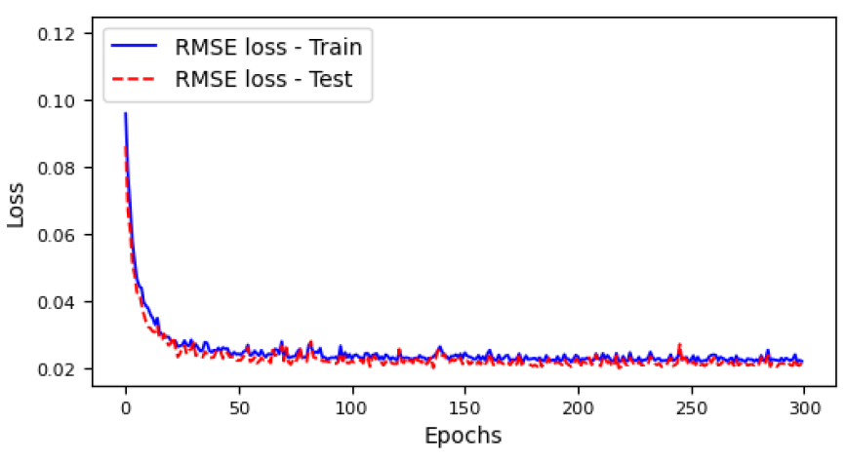
Training Convergence: RMSE Loss Curve
The RMSE loss drops quickly during the first few epochs, showing fast learning.
Both training and testing curves stay close, meaning:
No overfitting
Good generalization
After ~50 epochs, the loss stabilizes around a low and consistent value.
Fig 4. RMSE values of the training and testing sets.
Takeaway
The GNN converges well and maintains low prediction error on both training and unseen test samples, indicating stable learning and strong generalization.
17

Slide 17
Results: Prediction Performance
Table 5. Average And 90th Percentile MAPE (%) of GNN And NN On Holdout Configurations: GNN | NN
Scenario | Dataset | Average MAPE (%) | 90th
Config 1 as holdout | Training | 8.1 | 6.9 | 11.8 | 16.4
 | Test | 8.3 | 6.6 | 11.6 |16.4
 | Holdout | 13.9 | 28.5 | 24.1 | 60.2
Config 2 as holdout | Training | 9.3 | 6.1 | 15.3 | 14.4
 | Test | 9.9 | 6.0 | 15.8 | 14.3
 | Holdout | 10.7 | 11.1 | 13.4 | 25.3
Config 3 as holdout | Training | 7.3 | 6.0 | 10.8 | 14.6
 | Test | 7.4 | 6.1 | 11.1 | 14.6
 | Holdout | 13.5 | 17.1 | 17.8 | 29.2
The GNN achieves ~2× lower prediction error and maintains accuracy even when tested on unseen configurations, demonstrating strong generalization and robustness for dynamic networks.
18

Slide 18
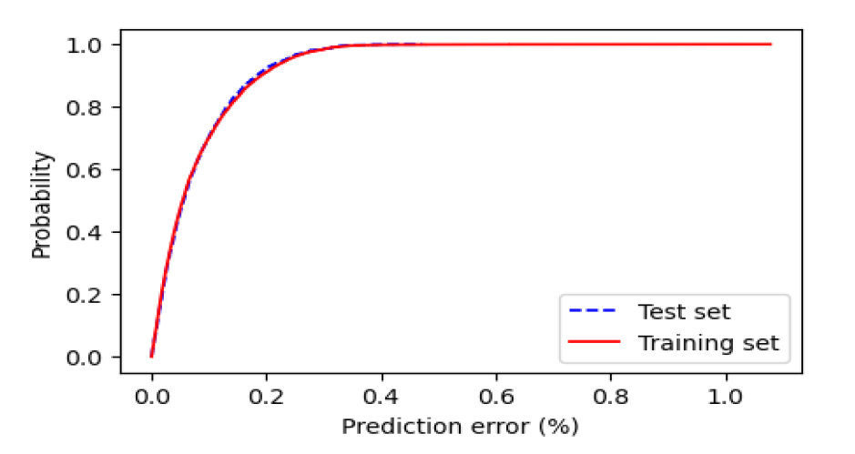
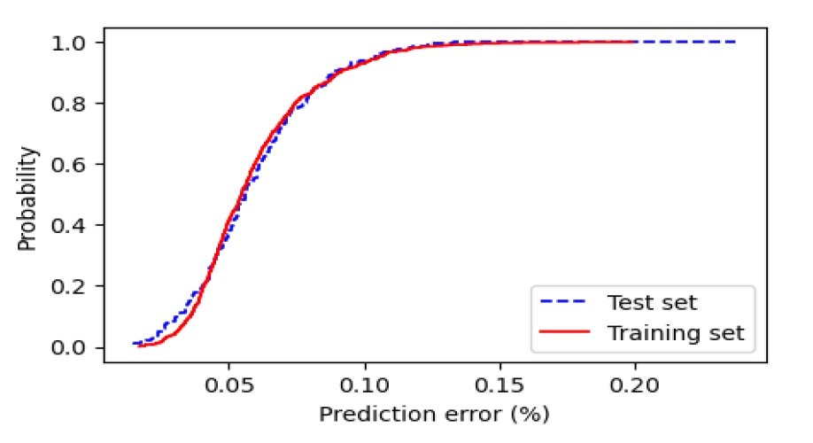
Results Comparison of GNN vs Baseline Neural Network
GNN Model Error Distribution
Tight curve → Most predictions are close to ground truth
Train and test nearly overlap → No overfitting
Baseline Neural Network Distribution
Broader curve → Higher and more variable errors
Train vs test diverge more → Less stable/generalizable
Fig 5. CDF of prediction errors by the GNN agent.
Fig 6. CDF of prediction errors by the baseline neural network.
Takeaway
The GNN learns how topology influences latency, while the baseline NN sees only raw values, leading to better prediction accuracy and stability.
19

Slide 19
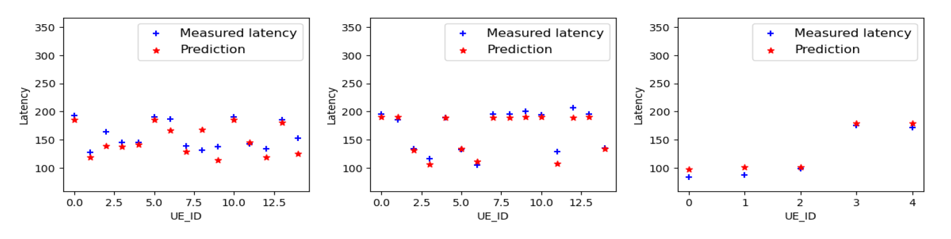
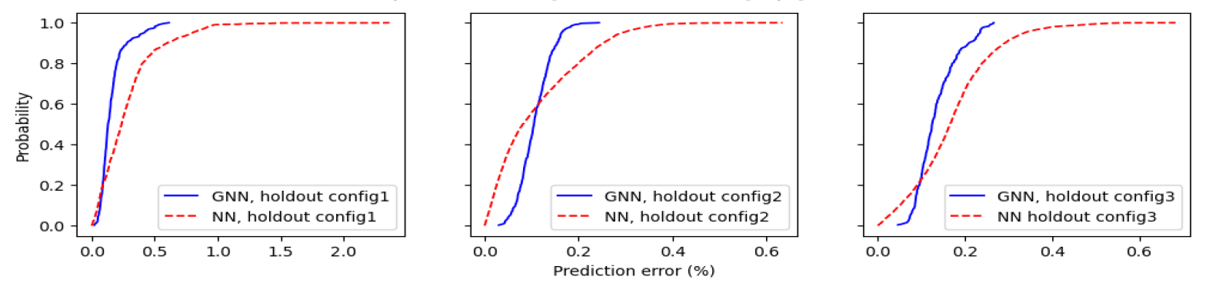
GNN Training and Prediction Results
Prediction Accuracy
The plots in Figure 7 show that the predicted latency (red stars) closely follows the real measured latency (blue crosses).
Fig 7. Measured and predicted latency for sample graphs.
Error Distribution
The blue curve (GNN) is consistently shifted left → meaning lower prediction errors
The red curve (baseline NN) has significantly higher errors.
Fig 8. CDF of prediction errors on holdout datasets
The GNN model provides significantly lower prediction errors and maintains strong performance even on unseen configurations, making it a reliable choice for real-time intent prediction in dynamic 5G/6G networks.
20

Slide 20
Why Graph Neural Networks?
Advantages over traditional approaches
Traditional Neural Networks
Graph Neural Networks
Fixed input size requirements
Variable graph size handling
Cannot capture network topology
Natural network representation
Poor scalability to larger networks
Excellent scalability
Limited Generalization
Superior generalization
Require extensive training data
Learn from graph structure
GNN Key Properties
Output does not depend on node ordering
Nodes exchange information with neighbors
21

Slide 21
Why Does GNN Generalize Better?
1. Topology-Aware Learning
GNN learns from graph structure, capturing relationships between nodes (UEs, gateways, clusters) regardless of specific configuration.
2. Message Passing Mechanism
Information propagates through network topology, mimicking actual signal flow in real networks.
3. Permutation Invariance
GNN output is independent of node ordering, making it robust to different network configurations.
4. Shared Parameters
Same update functions applied across all nodes of same type, enabling transfer to different scales.
Baseline NN Limitation
Traditional NNs treat each UE's features independently without considering network topology. They cannot capture how a UE's latency is affected by other UEs competing for bandwidth or by cluster proximity.
Key Insight: GNN's ability to model network topology as a graph enables learning transferable patterns that generalize to new configurations.
22

Slide 22
Key Contributions and Advantages
1. Novel Application of GNN in Intent-Based Networks
First work to use GNN as prediction agents within Intent Management Functions for autonomous conflict detection
2. Heterogeneous Graph Modeling Methodology
Detailed framework for modeling latency prediction as node-level regression on heterogeneous graphs (multiple node types)
3. Comprehensive Evaluation
55% better accuracy than baseline NN
Up to 60% better generalization to unseen configurations
Real-world validation on production-grade emulator
4. Practical Deployment Path
Demonstrates that GNN-based prediction agents are accurate (6-9% MAPE) and fast enough for real-time conflict detection
This work enables fully autonomous, zero-touch network management essential for 6G networks
23

Slide 23
Conclusion
1. Problem: Intent-based networks need accurate prediction agents for conflict detection, but traditional ML approaches show poor generalization.
2. Solution: Graph Neural Networks naturally model network topology and enable accurate, scalable predictions.
3. Results: GNN achieves 6-9% MAPE (55% better than baseline) with superior generalization (up to 60% improvement).
4. Impact: Enables autonomous network management essential for 6G with zero-touch operation.
5. Significance: First application of GNN for prediction agents in Intent Management Functions, paving the way for fully autonomous networks.
GNNs are a promising modeling approach for network environments that enable predictions in a scalable and generalizable manner. Predict the latency of URLLC users based on the current network state.
24

Slide 24
Limitations and Challenges
Current Limitations
1. Single KPI Prediction: Only predicts latency; real IMF needs multiple KPIs (throughput, packet loss, QoE) simultaneously.
2. Limited-Service Scenarios: Tested only on URLLC + WebRTC; production needs diverse services (eMBB, mMTC, etc.).
3. Controlled Environment: Network emulator is simplified compared to real-world deployments with unpredictable interference.
4. Computational Overhead: GNN training and inference require more computation than simple models (though still real-time capable).
5. Data Requirements: Needs sufficient training data covering diverse configurations.
Practical Challenges
Integration with existing network management systems
Handling network topology changes
Model update/retraining strategy
25

Slide 25
Discussion on Limitations
Limitation 1: Limited Scope of KPIs
Limitation 2: Scale of Experiments
Current Work:
├─ Focuses primarily on latency prediction
├─ Single KPI as prediction target
└─ Two service types (URLLC + Video)
Real Networks Need:
├─ Multiple KPI predictions simultaneously
│ • Latency
│ • Throughput
│ • Packet loss
│ • Jitter
│ • Energy consumption
│ • Cost
├─ Dozens of service types
└─ Complex interdependencies
Current Experiments:
├─ Maximum 20 UEs total
├─ Single base station
├─ 3 clusters
└─ Relatively small network
Real Networks Have:
├─ Thousands to millions of UEs
├─ Hundreds of base stations
├─ Complex multi-tier architecture
└─ Global distribution
26

Slide 26
Discussion on Limitations
Limitation 3: Limited Network Dynamics
Limitation 4: Single Prediction Target
Current Evaluation:
├─ Static snapshots of network state
├─ Actions applied, then measure
├─ No continuous temporal evolution
└─ No mobility patterns
Real Networks Have:
├─ Continuous state changes
├─ User mobility (handovers)
├─ Traffic patterns vary over time
├─ Seasonal and daily variations
└─ Sudden bursts and flash crowds
Current Design:
├─ Predicts latency for URLLC UEs
├─ Node-level regression problem
└─ One output per target node
Needed for Full IMF:
├─ Predict ALL KPIs for ALL intents
├─ Graph-level predictions
├─ Multi-output regression
├─ Cross-service impact predictions
└─ Confidence intervals
27

Slide 27
Future Work
1. Multi-KPI Prediction
Extend GNN to simultaneously predict multiple KPIs (latency, throughput, packet loss, QoE) for comprehensive conflict detection
2. Expanded Service Coverage
Include more service types: eMBB (enhanced Mobile Broadband), mMTC (massive Machine Type Communications), AR/VR applications
3. Complete IMF Integration
Deploy multiple GNN prediction agents within full Intent Management Function and evaluate end-to-end conflict resolution capability
4. Online Learning and Adaptation
Develop mechanisms for continuous model updating as network conditions evolve without full retraining
28

Slide 28
References (1/2)
[1] D. A. Temesgene, E. D. Biyar, A. Silva, A. Likhyani, and A. Zahernszky, "Graph Neural Network for Building Prediction Agents in Intent-Based Zero-Touch Networks.
[2] P. H. Gomes, M. Buhrgard, J. ," in ICC 2024 – IEEE International Conference on Communications, Denver, CO, USA, pp. 974–979, 2024. doi: 10.1109/ICC51166.2024.10622342 Harmatos, S. K. Mohalik, D. Roeland, and J. Niemöller, "Intent-driven closed loops for autonomous networks," Journal of ICT Standardization, pp. 257–290, 2021.
[3] J. Niemöller, R. Szabó, A. Záhemszky, and D. Roeland, "Creating autonomous networks with intent-based closed loops," Ericsson Technology Review, vol. 2022, no. 4, pp. 2–11, 2022.
[4] A. C. Baktir, A. D. N. Junior, A. Záhemszky, A. Likhyani, D. A. Temesgene, D. Roeland, E. D. Biyar, R. F. Ustok, M. Orlic, and M. D'Angelo, "Intent-based cognitive closed-loop management with built-in conflict handling," in 2022 IEEE 8th International Conference on Network Softwarization (NetSoft), pp. 73–78, 2022.
[5] S. He, S. Xiong, Y. Ou, J. Zhang, J. Wang, Y. Huang, and Y. Zhang, "An overview on the application of graph neural networks in wireless networks," IEEE Open Journal of the Communications Society, vol. 2, pp. 2547–2565, 2021.
[6] Y. Shen, J. Zhang, S. H. Song, and K. B. Letaief, "Graph neural networks for wireless communications: From theory to practice," IEEE Transactions on Wireless Communications, vol. 22, no. 5, pp. 3554–3569, 2023.
[7] L. Hui, M. Wang, L. Zhang, L. Lu, and Y. Cui, "Digital twin for networking: A data-driven performance modeling perspective," IEEE Network, vol. 37, no. 3, pp. 202–209, 2023.
[8] J. Skarding, B. Gabrys, and K. Musial, "Foundations and modeling of dynamic networks using dynamic graph neural networks: A survey," IEEE Access, vol. 9, pp. 79143–79168, 2021.
29

Slide 29
References (2/2)
[9] H. Wang, Y. Wu, G. Min, and W. Miao, "A graph neural network-based digital twin for network slicing management," IEEE Transactions on Industrial Informatics, vol. 18, no. 2, pp. 1367–1376, 2022.
[10] M. Farreras, P. Soto, M. Camelo, L. Fàbrega, and P. Vilà, "Improving network delay predictions using gnns," Journal of Network and Systems Management, vol. 31, no. 4, p. 65, 2023.
[11] K. Rusek, J. Suárez-Varela, P. Almasan, P. Barlet-Ros, and A. Cabellos-Aparicio, "Routenet: Leveraging graph neural networks for network modeling and optimization in sdn," IEEE Journal on Selected Areas in Communications, vol. 38, no. 10, pp. 2260–2270, 2020.
[12] Z. Ge, J. Hou, and A. Nayak, "Gnn-based end-to-end delay prediction in software defined networking," in 2022 18th International Conference on Distributed Computing in Sensor Systems (DCOSS), pp. 372–378, 2022.
[13] P. Larrenie, J.-F. Bercher, O. Venard, and I. Lahsen-Cherif, "Low complexity approaches for end-to-end latency prediction," in 2022 13th International Conference on Computing Communication and Networking Technologies (ICCCNT), pp. 1–6, IEEE, 2022.
[14] D. S. H. Tam, Y. Liu, H. Xu, S. Xie, and W. C. Lau, "Pert-gnn: Latency prediction for microservice-based cloud-native applications via graph neural networks," in Proceedings of the 29th ACM SIGKDD Conference on Knowledge Discovery and Data Mining, KDD '23, (New York, NY, USA), p. 2155–2165, Association for Computing Machinery, 2023.
[15] T. A. Khan, A. Muhammad, W. Akbar, A. Mehmood, A. Rafiq, and W.-C. Song, "Intent-based networking approach for service route and qos control on koren sdi," in 2021 IEEE 7th International Conference on Network Softwarization (NetSoft), pp. 24–30, 2021.
[16] A. Romero-Garcés, A. Hidalgo-Paniagua, M. González-García, and A. Bandera, "On managing knowledge for mape-k loops in self-adaptive robotics using a graph-based runtime model," Applied Sciences, vol. 12, no. 17, p. 8583, 2022.
30

Slide 30
Thank You
31

